Slide 1
How To Create, Grow, And Manage Wealth In Business Families?
Mag. Lucia Lucka Klansek

Slide 2
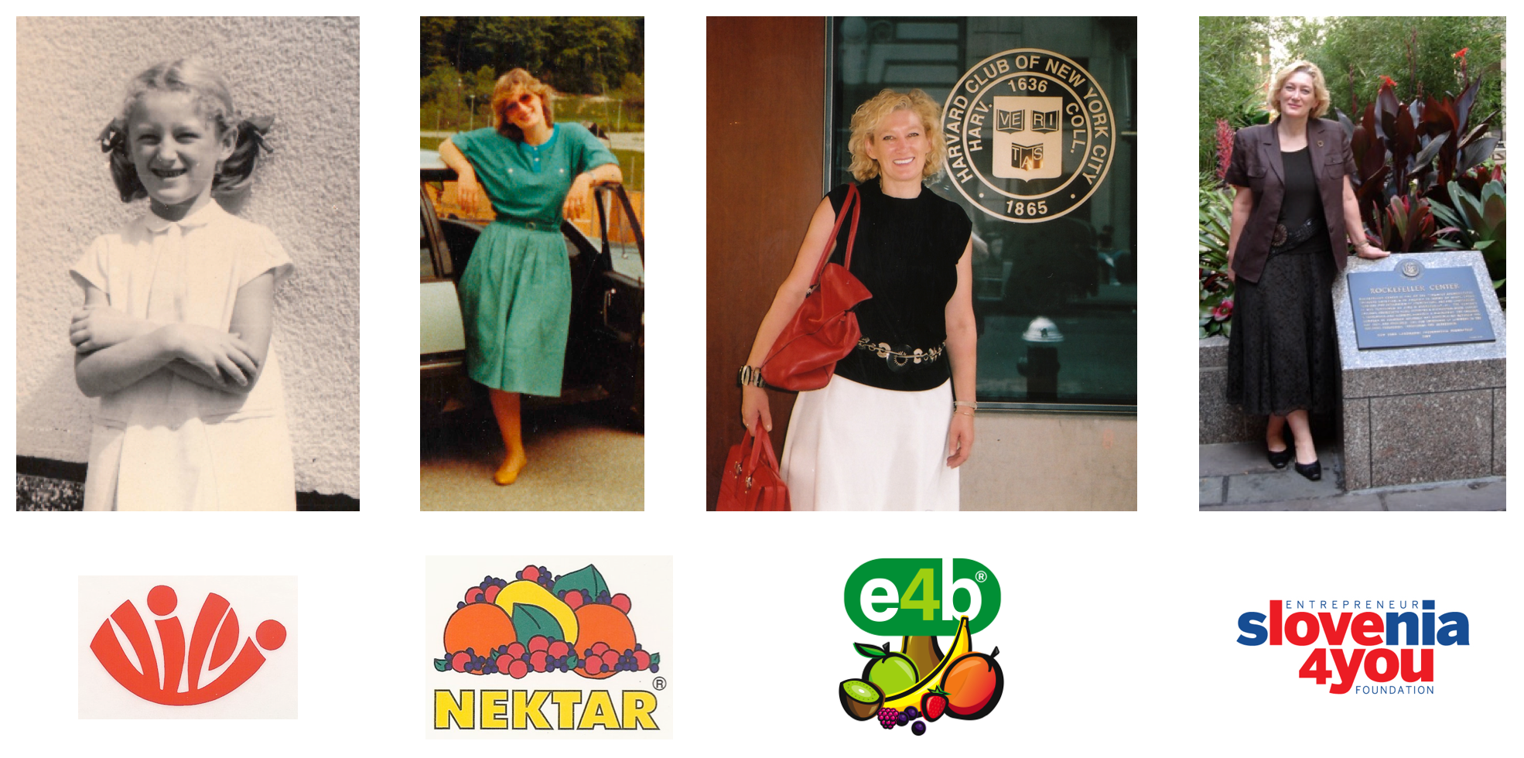
My Journey

Slide 3
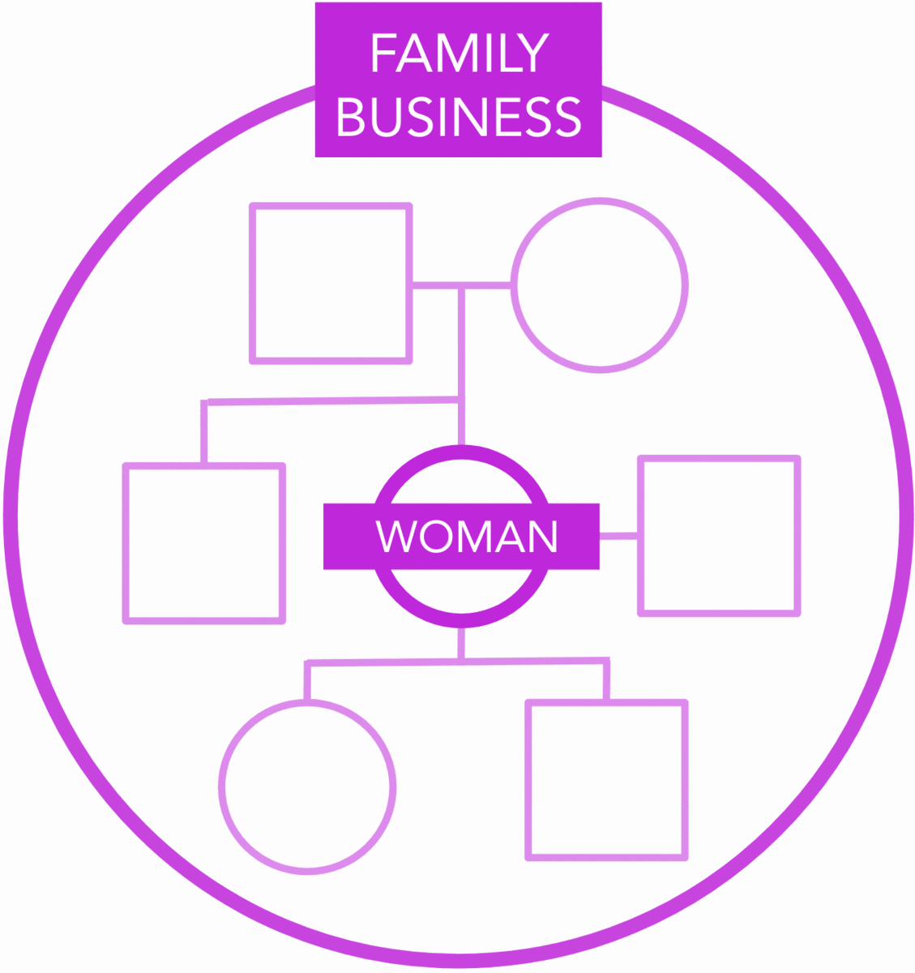
Roles of Women in Business Families
Woman
Entrepreneur
Daughter
Wife
Mother

Slide 4
Women have the power, if they use it, to transmit a positive or negative image of the family enterprise to the children.
Mothers teach family members how to get along together, in and out of business.
The role of “Chief Emotional Officer” is essential to the success of the Family Business.

Slide 5
Family Businesses are Better
Better In
Sales
Profits
Growth
Efficiency
*2/3 of all business worldwide are family owned
Non-Family
Business
Family
Business
Number of Businesses
Low Performance High

Slide 6
From Generation to Generation
1st generation: 100 Companies
2nd Generation: 30 Companies
3rd Generation: 14 Companies

Slide 7
Family Business Cycles

Slide 8
Succession and Momentum
A - Successor not yet ready
B - Probably good enough to take Over
C - Momentum is gone
B
A
C
Contribution of Leader
Incoming Successor
Outgoing
Leader
Time

Slide 9
The Natural Laws of
Family Business

Slide 10
Natural Law #1
FAMILIES GROW FASTER THAN BUSINESSES
~SO~
Successful Families put Business financial needs first, regarding them as more important than individual family needs.

Slide 11
Natural Law #2
FAMILY LIFESTYLE EXPECTATIONS GO UP OVER GENERATIONS
~SO~
Successful Business Families focus on creating things of lasting value and make wealth, comfort and status low priorities.

Slide 12
Natural Law #3
FAMILIES BECOME FINANCIALLY DEPENDENT IN THE BUSINESS
~SO~
To protect the family business from unaffordable family financial needs, families control their financial expectations from the business.

Slide 13
Natural Law #4
FAMILIES PUT ALL THEIR EGGS IN ONE BASKET
~SO~
To generate some of the income the family needs, smart families diversify their investments.

Slide 14
Natural Law #5
FAMILIES TEND TO BECOME FRAGMENTED AND LESS UNITED OVER TIME MAKING ALL ISSUES DIFFICULT TO ADDRESS
~SO~
Successful Business families build a governance system that builds family unity while ensuring that tough decisions can be made in a timely way.

Slide 15
5 Lessons
They stay united around their mission of long-term value creation and their values.
They are champions of operational excellence, timely change, and long-term value creation.
They invest in what they value and can grow, and they ‘partner’ with others to bring in expertise/resources.
They nurture family wealth creators and active owners with an owner mindset.
They build family engagement, unity and contribution with an updated array of activities and investments.

Slide 16
The winning family mission
BUILD
VALUE
According to Your
VALUES
Types of value
Financial
Intellectual Property
Social Impact
Reputational
Relational
Talent

Slide 17
Building blocks for the direction of a family entreprise
VALUES - Who are we, which core values and principles guide our choices and behaviours?
MISSION- Why we want to build our enterprise together? What is our purpose?
VISION - What we want to build and be in 3, 5,10 years?
STRATEGY - How we get there?

Slide 18
3 pathways
Pathway 1
Business
Family
Wealth highly concentrated in operating companies that the family controls
Pathway 2
Business + Investment
Family
Significant assent in both operating business and financial investments.
Pathway 3
Financial
Family
Moved out of operating business and into mostly passive financial investment.

Slide 19
To stay alive for generations…
Family companies need to innovate but also shift to new value-creating activities and leave behind activities that destroy value.

Slide 20
Owner mindset
Operator Mindset

Slide 21
Wealth creators and Active Owners
Must take the lead in designing the portfolio of activities and investments.

Slide 22
The owners mindset requires that OWNERS
GAIN ALTITUDE
TO TAKE A PORTFOLIO VIEW OF THEIR ASSETS
Families that do this well, take a holistic view of their
total assets, activities, and wealth plan,
to create a resilient multi-generational wealth strategy

Slide 23
